Slide 1

Questions to Consider
While you’re waiting for the presentation to begin, please reflect on the questions below.
What authentic experiences do your graduate students take part in?
What challenges do you have
developing these experiences?

Slide 2
Bridging the Gap:
Connecting Aspiring Principals with Practicing Leaders
OCTEO 2026

Slide 3
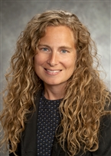
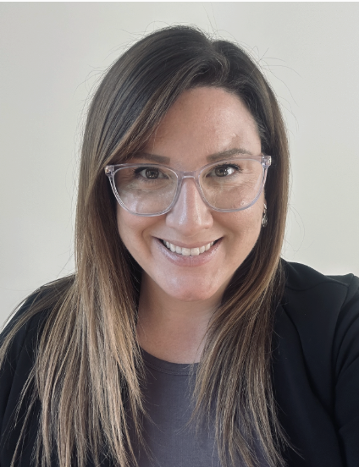

Introductions
Fun Fact:
I was a race
walker in college!
Fun Fact:
Every Fall, I go on the coffee trail!
Dr. Jennifer Hollinger
Dr. Caitlin Reash
Associate Professor, School of Education
Director of Institutional Effectiveness
Teaching:
- Mathematics Methods Courses
- Introduction to Education
- School Finance
- Supervision, Evaluation, & Professional Development
Assistant Professor, School of Education
Teaching:
- Principal Internship I & II
- Primary Math Methods
- Interdisciplinary Planning

Slide 4


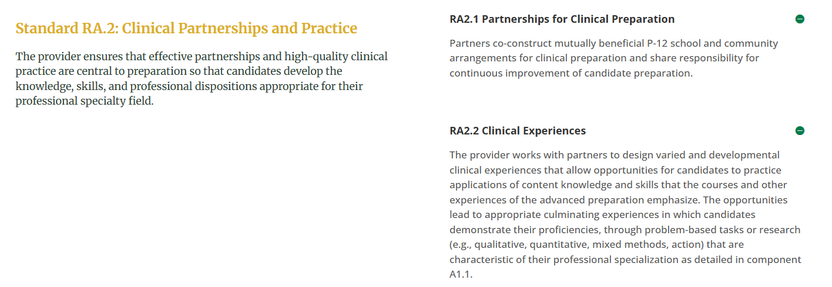
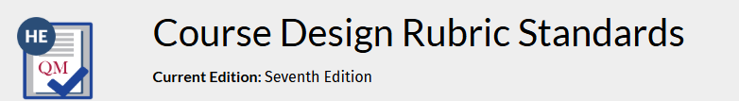

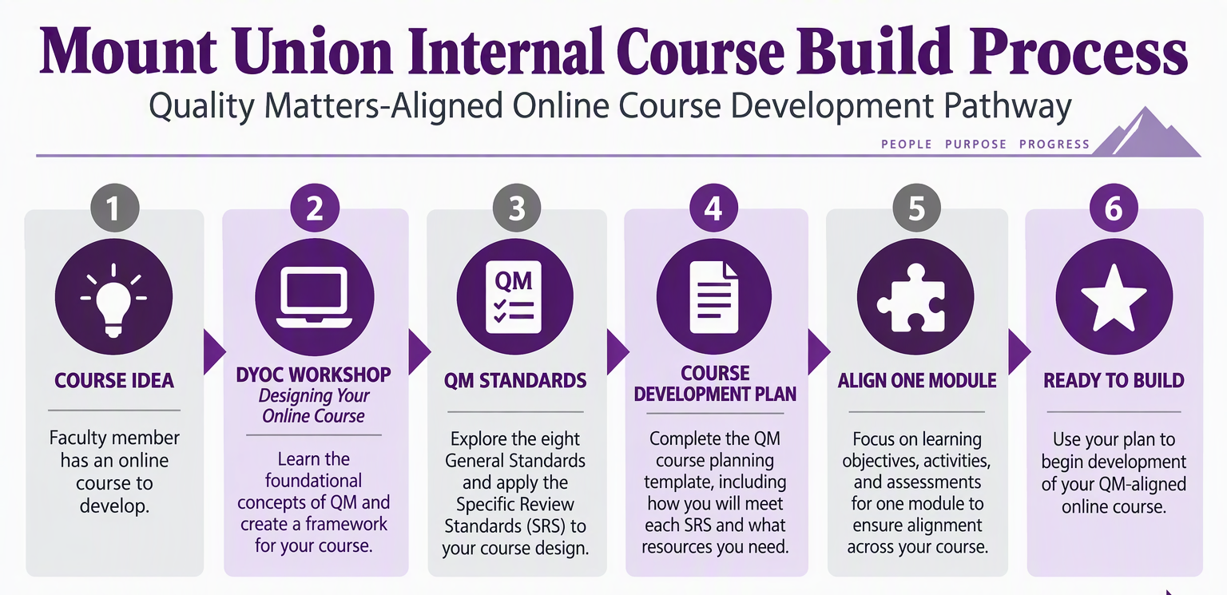
Program and Course Considerations

Slide 5
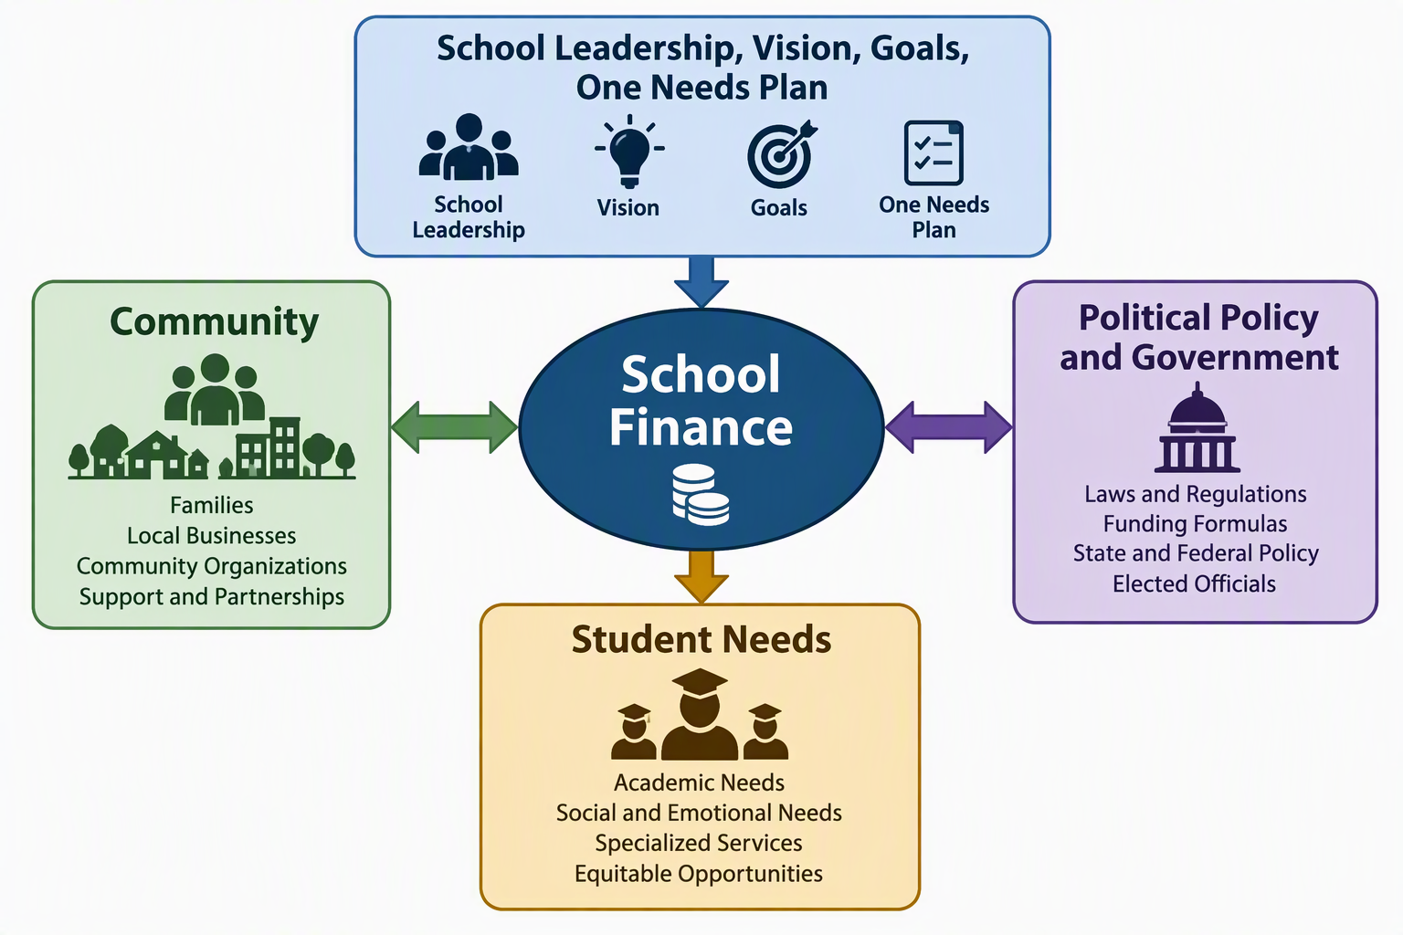
School Finance

Slide 6
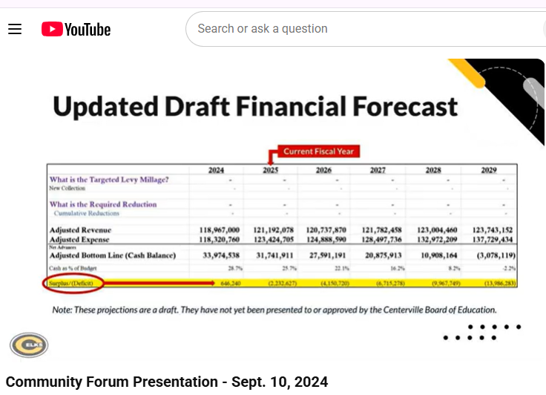
YouTube

Slide 7
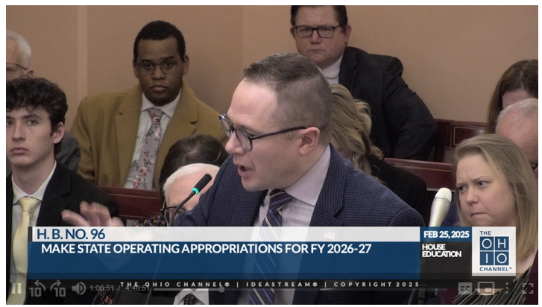
The Ohio Channel

Slide 8
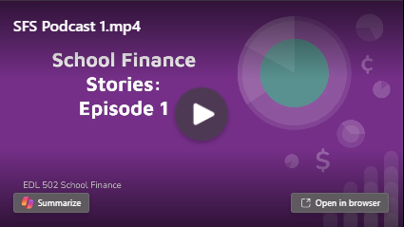
Podcast

Slide 9
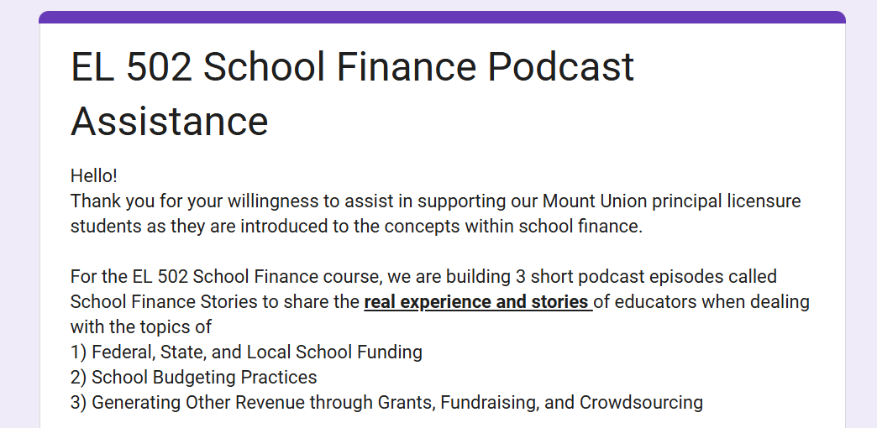
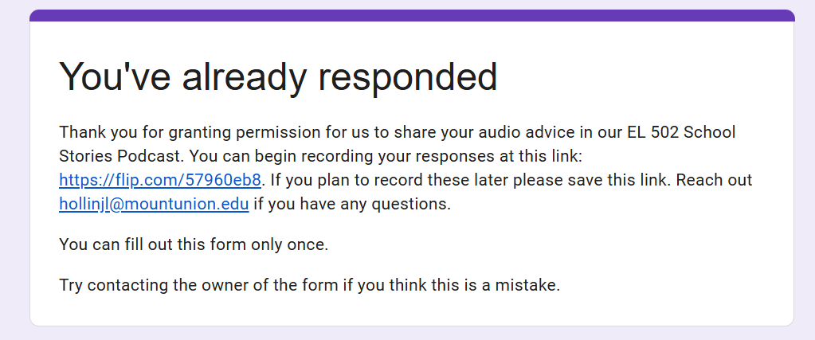
Permissions

Slide 10
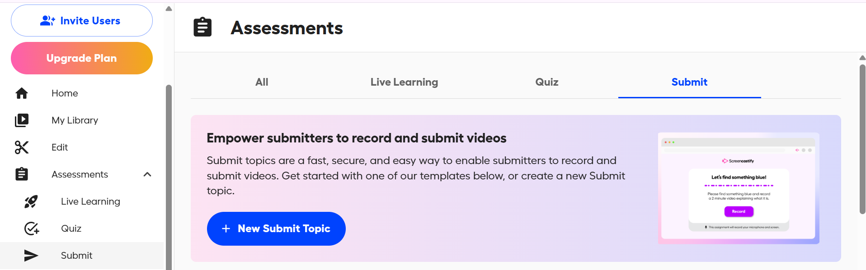
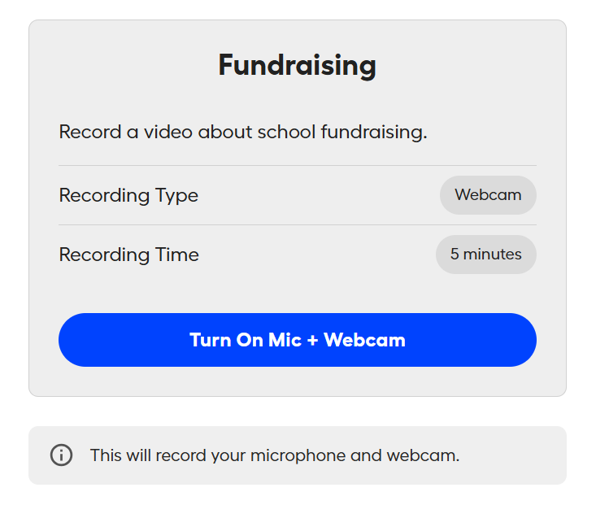
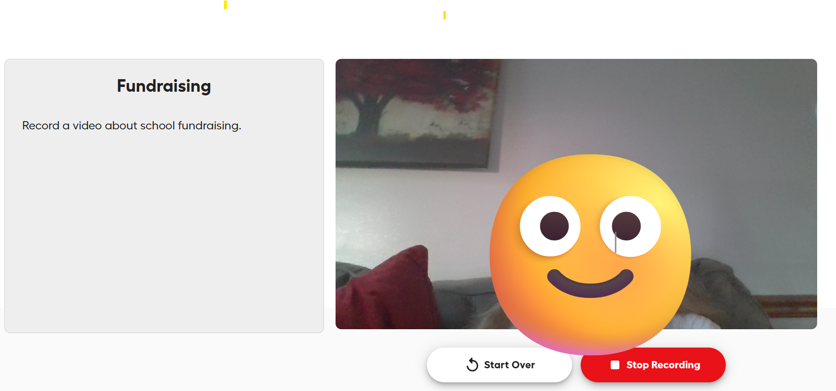

Screencastify
Submit

Slide 11
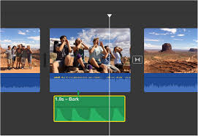

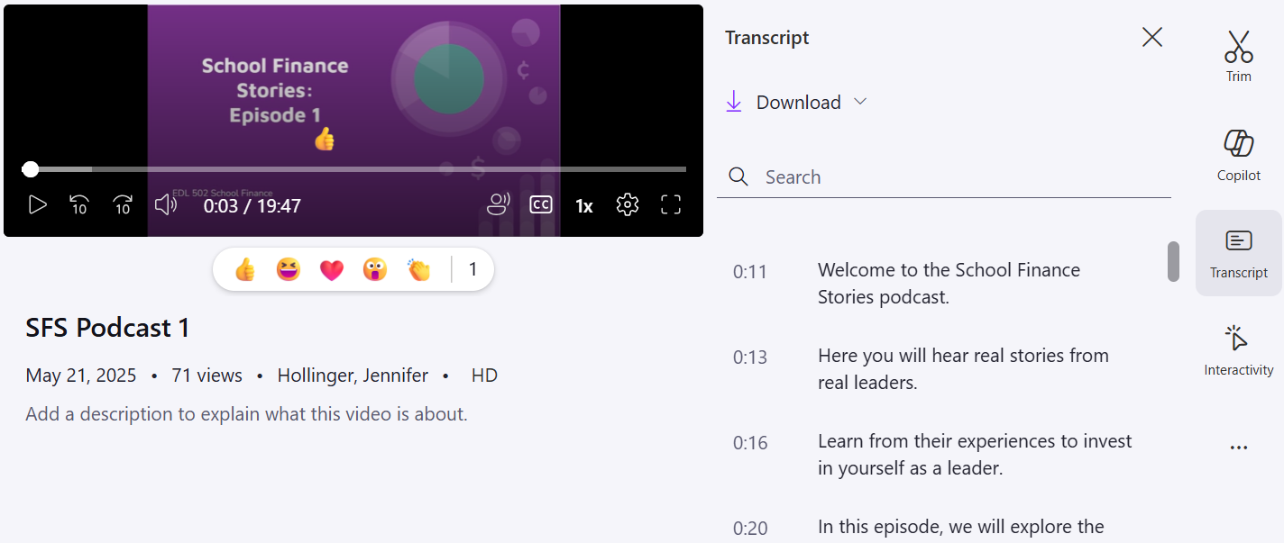
iMovie & Stream

Slide 12
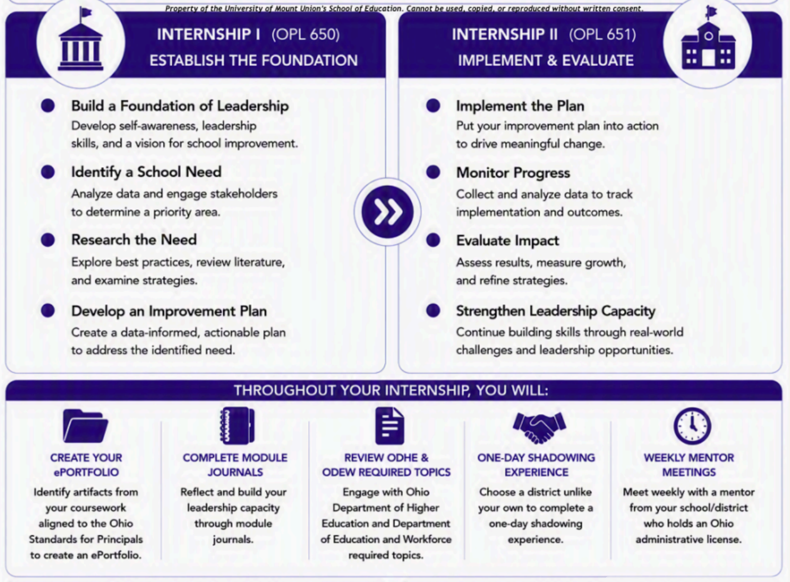
Principal Internships I & II
28-Weeks
Applications
Authentic Leadership Experiences
Course context in action/leading change
Aligned
Connections
OSP, ODEW, ODHE, NELP, CAEP
Internal & External

Slide 13
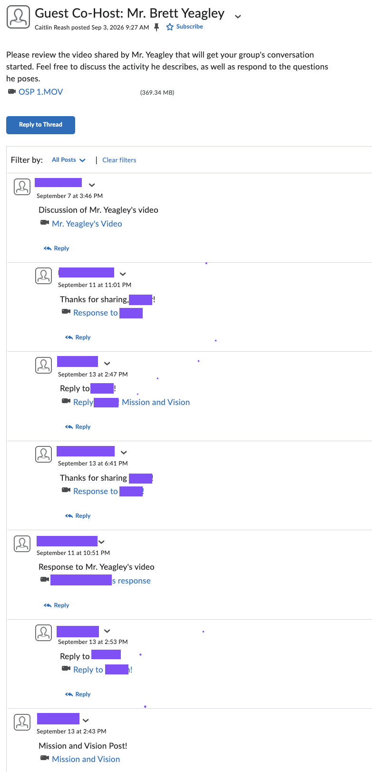
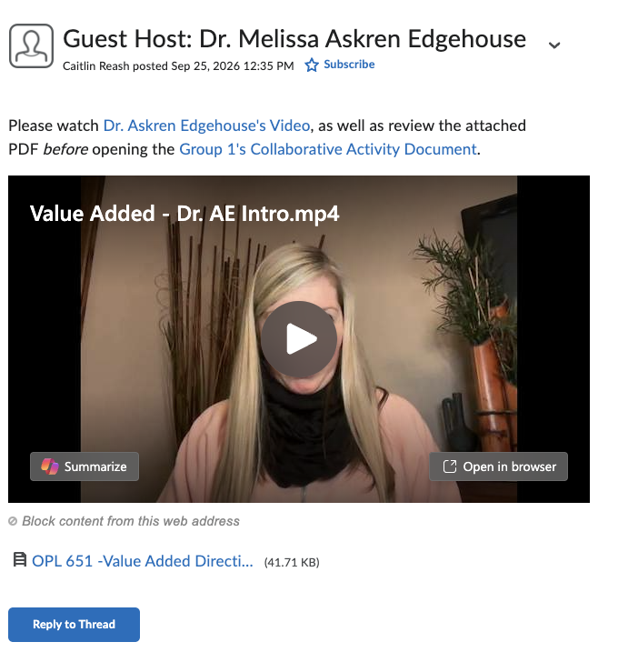
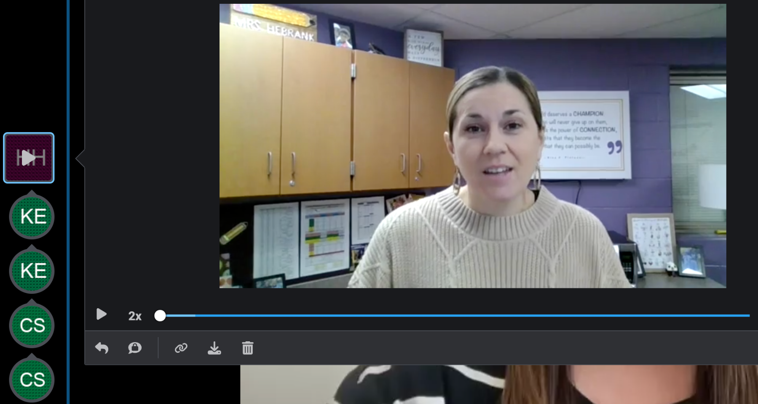
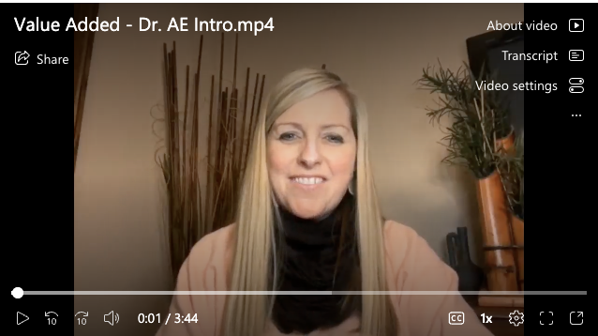
Connections
Experts & Strong Partners
Guest Speaker Format
Standards-Aligned
Non-Evaluative
Non-Identifiable Details

Slide 14
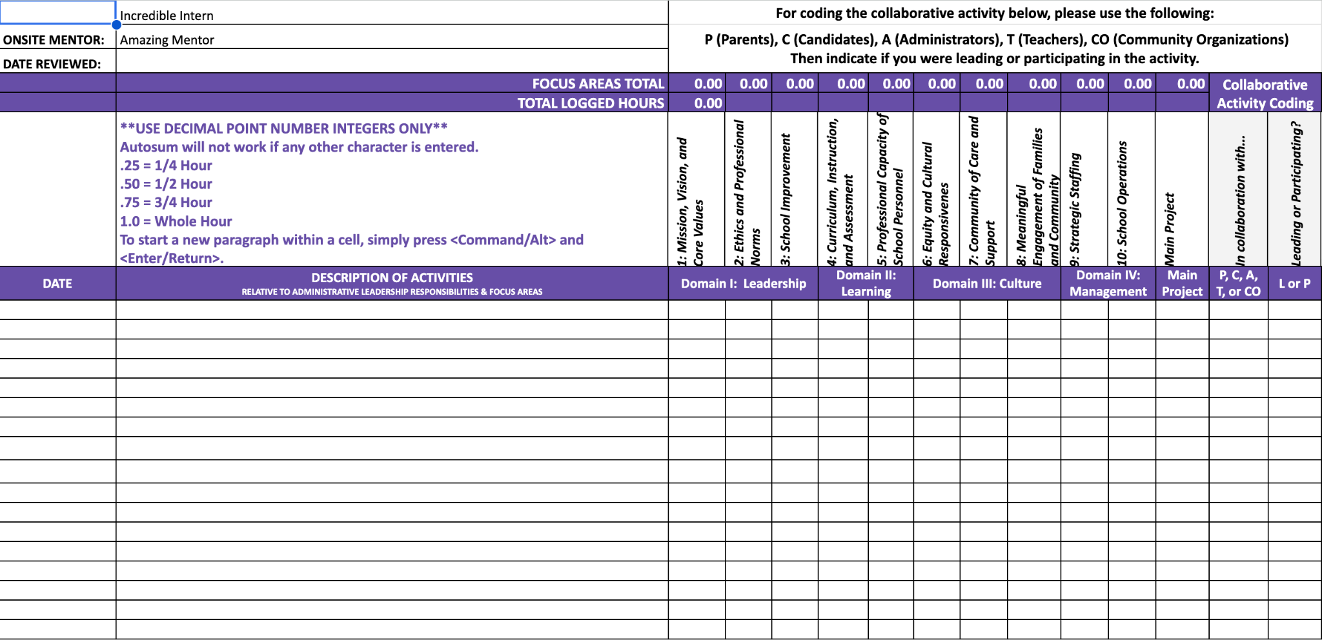
Collaborative OSP-Aligned Time Log

Slide 15
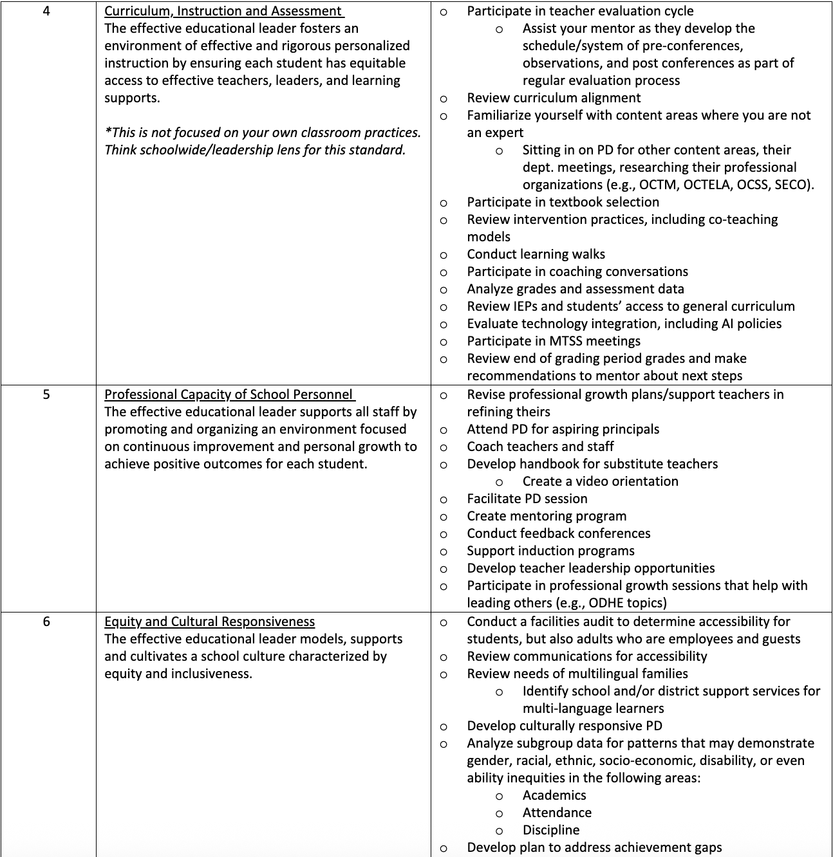
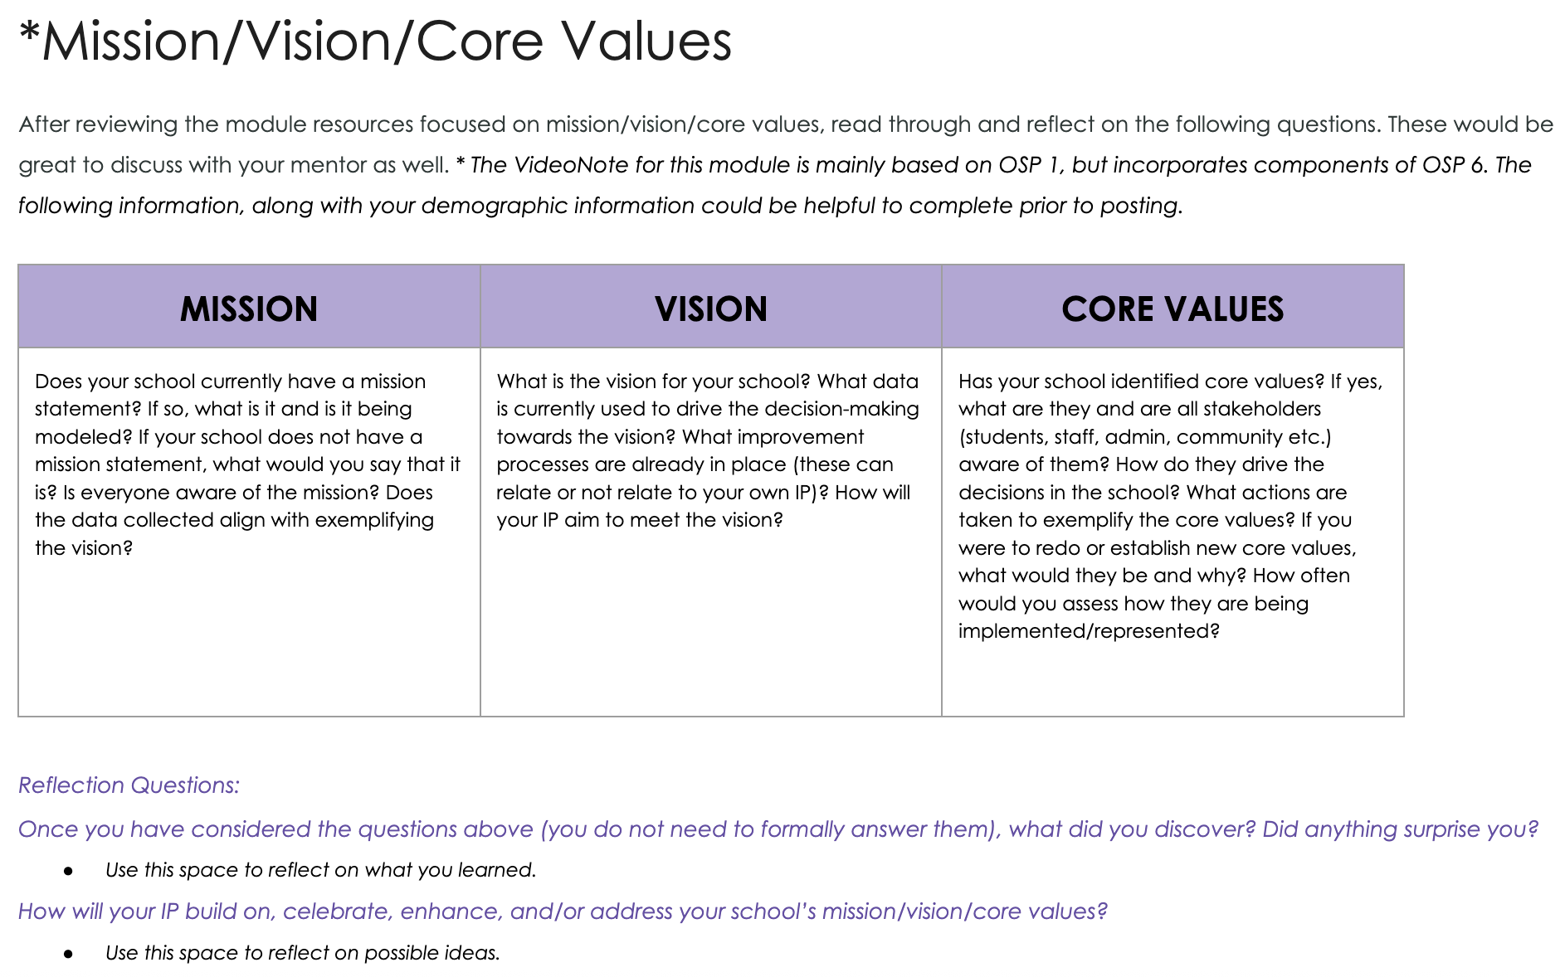
Ideas for Internship Activities

Slide 16
Networking Project
Perspective
Research
Flexibility
Takes place in a setting unlike their own (e.g., typology, grade- bands, position)
Learn about the site, areas of strength, growth, ties to improvement project, etc.
One day or two half days & responsive to district requirements. Flexibility with presentation format as well.

Slide 17
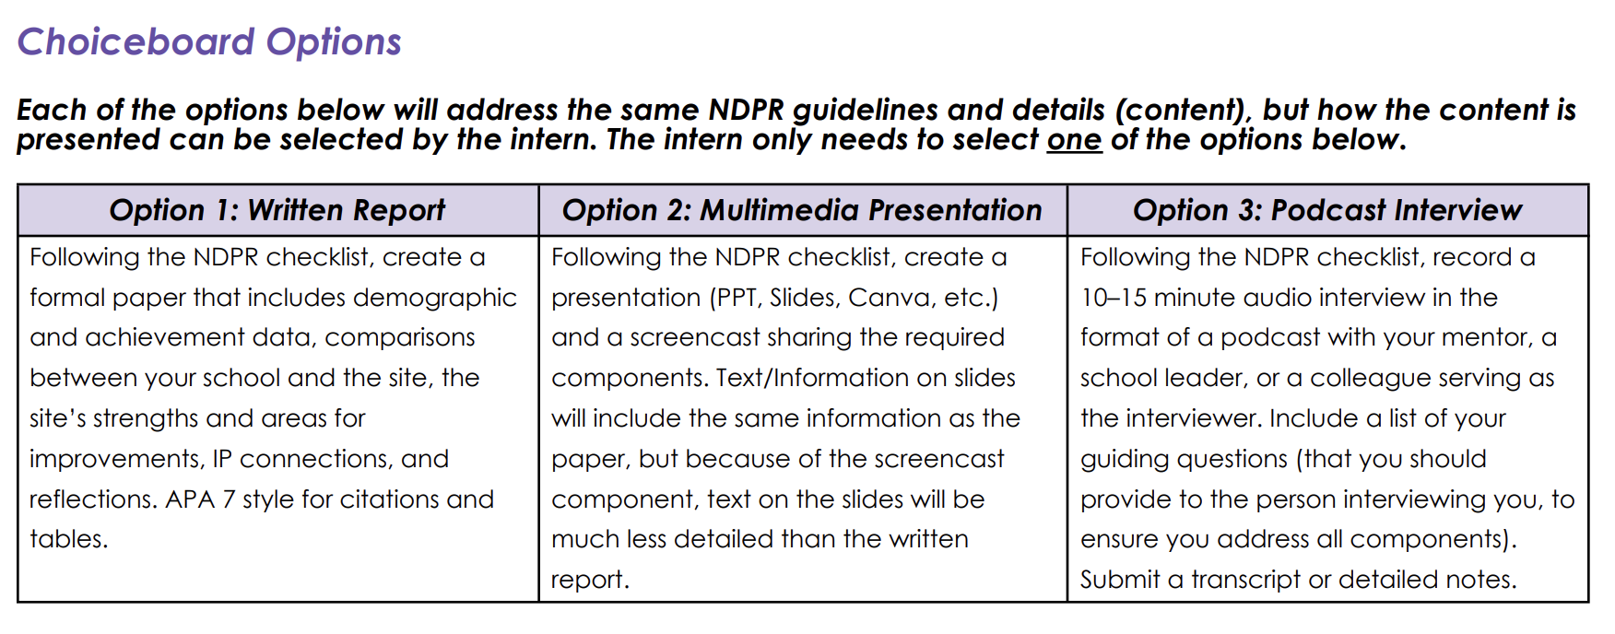
Presentation Options

Slide 18
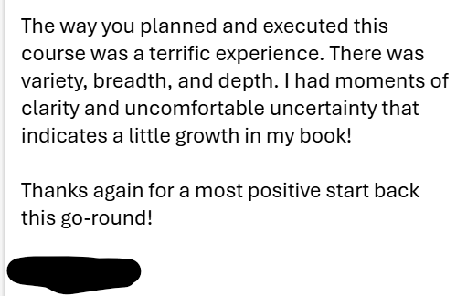
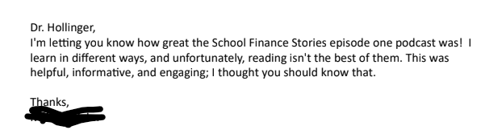
Feedback
I did really enjoy this project/assignment and was able to take away so much information from the experience. (This assignment is one I would definitely recommend keeping in the program.)
One of the most valuable aspects of the course was the internship hour requirement because it required me to connect real leadership experiences to the Ohio Principal Standards in authentic ways…That level of practical reflection was one of the most meaningful parts of the course. (CoursEval = anonymous)
I also wanted to tell you that I took the OAE assessment this morning. I feel like my experience and the coursework throughout the Mount Union program truly prepared me for the exam.

Slide 19
Research Overview
Meaningful Internship Experiences
Access
Quality Preparation Improves Outcomes
Only 40% of principals reported having had an internship during their preparation that allowed them to take on real leadership responsibilities characteristic of a high-quality internship experience, and very few in-service principals reported having access to coaching or mentoring.
Principals in high-poverty schools have significantly less access to high-quality learning opportunities, including mentoring, coaching, and cohort-based preparation, than their peers in low-poverty schools. Despite a strong desire for additional professional development, many principals face barriers such as limited time and insufficient funding to participate.
The literature illustrates the importance of field-based internships and problem-based learning opportunities. The efficacy of these opportunities is enhanced when they include an experienced mentor or coach who can provide support and guidance.
Darling-Hammond, L., Wechsler, M. E., Levin, S., Leung-Gagné, M., & Tozer, S. (2022). Developing effective principals: What kind of learning matters? [Report]. Learning Policy Institute. https://doi.org/10.54300/641.201. Updated September 14, 2023.

Slide 20
Questions & Takeaways
Discuss the following questions with those around you.
What authentic experiences do your graduate students take part in?
What challenges do you have
developing these experiences?
What is something you took away from today?

Slide 21


